Slide 1
IBM Data Science Capstone Project
SpaceX Falcon 9
Landing Prediction
End-to-end data science workflow: API data collection, web scraping, wrangling, SQL analysis, EDA, Folium maps, Plotly Dash dashboard and classification modeling.
Prepared by Omkar Sawant
https://github.com/OmkarSawant23/Data-Science-Capstone
4
90
4
83.3%
Launch sites
Falcon 9 records
ML models
Best test accuracy

Slide 2
Presentation Roadmap
Slide 2
01
Executive Summary
05
Predictive Analysis Methodology
02
Introduction & Business Problem
06
Results: Visualizations, Maps, Dashboard and ML
03
Data Collection and Wrangling
07
Innovative Insights
04
EDA, SQL and Interactive Visual Analytics
08
Conclusion and Appendix
IBM Data Science Capstone | SpaceX Falcon 9 Landing Prediction
Omkar Sawant

Slide 3
Executive Summary
Slide 3
REQUIRED SLIDE
Business value
Objective: predict whether the Falcon 9 first stage will land successfully.
Collected and prepared launch data using SpaceX API, web scraping, data wrangling and SQL.
Explored patterns with Seaborn/Matplotlib, Folium maps and a Plotly Dash dashboard.
Built classification models using standardized features and GridSearchCV.
Best test accuracy reached 83.3%, with Logistic Regression, SVM and KNN tying on the test set.
Landing prediction helps estimate launch cost because booster recovery is directly linked to reusability and mission economics.
Analytical value
Combining SQL, EDA, geospatial analysis and ML provided stronger evidence than relying on one method alone.
Key insight
Success generally improved over time, and launch outcome is influenced by launch site, orbit type, payload mass and booster category.
Repository
All notebooks, datasets, Dash app and outputs are stored on GitHub.
https://github.com/OmkarSawant23/Data-Science-Capstone
IBM Data Science Capstone | SpaceX Falcon 9 Landing Prediction
Omkar Sawant

Slide 4
Introduction: Problem Context
Slide 4
SpaceX Falcon 9 first-stage reuse is a major factor behind lower launch costs.
A successful landing reduces the cost of future launches by enabling booster reuse.
The core data science question: can historical launch information predict first-stage landing success?
The project follows a full workflow from data acquisition to machine learning and business interpretation.
Collect
Analyze
Visualize
Predict
API + web scraping
SQL + EDA
Folium + Dash
Classification models
Target variable
Class = 1 for successful first-stage landing; Class = 0 for failed or non-successful landing outcomes.
IBM Data Science Capstone | SpaceX Falcon 9 Landing Prediction
Omkar Sawant

Slide 5
GitHub Repository and Deliverables
Slide 5
1 POINT REQIREMENT
notebooks
datasets
Completed Jupyter notebooks for API, scraping, wrangling, SQL, EDA, maps and ML
CSV files and SQLite database used across the workflow
dash_app
outputs
Plotly Dash application file
Folium HTML maps, dashboard screenshots and visual evidence
presentation
Final PowerPoint and PDF report
The repository is structured to support reproducibility and review: code, data, dashboard assets and visual outputs are organized in separate folders.
IBM Data Science Capstone | SpaceX Falcon 9 Landing Prediction
Omkar Sawant

Slide 6
Data Collection and Data Wrangling Methodology
Slide 6
METHODOLOGY
1. API collection
2. Web scraping
SpaceX REST API used to collect launch records, rocket IDs, payload data, launchpad metadata and landing outcomes.
BeautifulSoup used to extract Falcon 9 launch records from historical web tables.
3. Cleaning
4. Label creation
Falcon 1 records removed, Falcon 9 records retained, missing PayloadMass values filled using the mean.
Landing outcomes transformed into binary Class label for predictive modeling.
Output datasets: dataset_part_1.csv, spacex_web_scraped.csv, dataset_part_2.csv
IBM Data Science Capstone | SpaceX Falcon 9 Landing Prediction
Omkar Sawant

Slide 7
EDA and Feature Engineering Methodology
Slide 7
METHODOLOGY
Visual exploration used Matplotlib and Seaborn scatter plots, bar charts and trend lines.
Core relationships tested: launch site, orbit type, payload mass, flight number and landing success.
Yearly launch success trend was created to check operational learning over time.
Categorical variables were converted using one-hot encoding to support ML modeling.
Raw launch data
EDA variables
One-hot encoding
ML feature set
Final EDA output
dataset_part_3.csv prepared for classification models.
IBM Data Science Capstone | SpaceX Falcon 9 Landing Prediction
Omkar Sawant

Slide 8
SQL Analysis Methodology
Slide 8
SQLite database my_data1.db was used to query the SpaceX launch dataset.
SQL queries applied filtering, grouping, aggregation, date extraction and sorting.
Analysis focused on launch site distribution, payload mass, booster versions, mission outcomes and landing outcome counts.
SELECT DISTINCT
GROUP BY
Unique launch sites
Mission outcome counts
AVG / SUM
WHERE + DATE
Payload mass summaries
Time-specific landing outcomes
Why SQL matters
SQL provided reproducible, question-driven validation of the same dataset before visualization and modeling.
IBM Data Science Capstone | SpaceX Falcon 9 Landing Prediction
Omkar Sawant

Slide 9
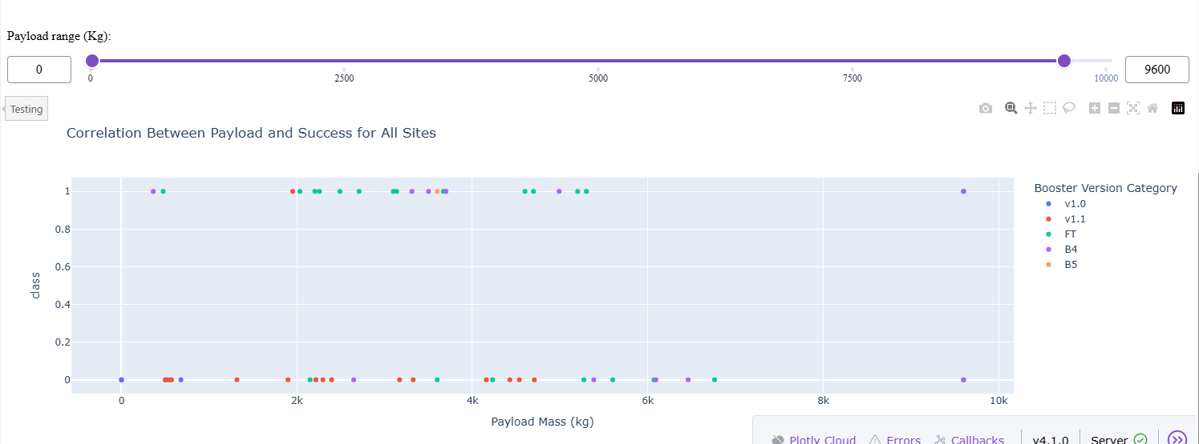
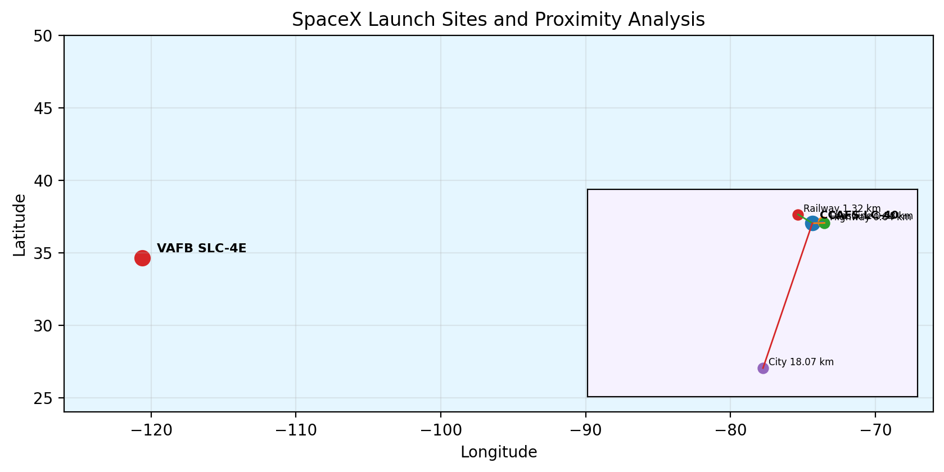
Interactive Visual Analytics Methodology
Slide 9
Folium geospatial analysis
Interactive launch-site maps were created to show launch locations, clustered success/failure markers and proximity to coastlines, cities, railway and highway features.
Plotly Dash dashboard
A Dash web application was built with a launch site dropdown, payload range slider, pie chart and payload-success scatter plot.
User interaction value
Users can filter sites and payload ranges to visually compare landing success patterns in real time.
IBM Data Science Capstone | SpaceX Falcon 9 Landing Prediction
Omkar Sawant

Slide 10
Predictive Analysis Methodology
Slide 10
Feature matrix
Target
One-hot encoded launch site, orbit, landing pad and booster serial features
Class label representing first-stage landing success
Preprocessing
Evaluation
StandardScaler applied to numerical feature matrix
Train-test split, GridSearchCV and test accuracy comparison
Models compared
Logistic Regression
Support Vector Machine
Decision Tree
K-Nearest Neighbors
IBM Data Science Capstone | SpaceX Falcon 9 Landing Prediction
Omkar Sawant

Slide 11
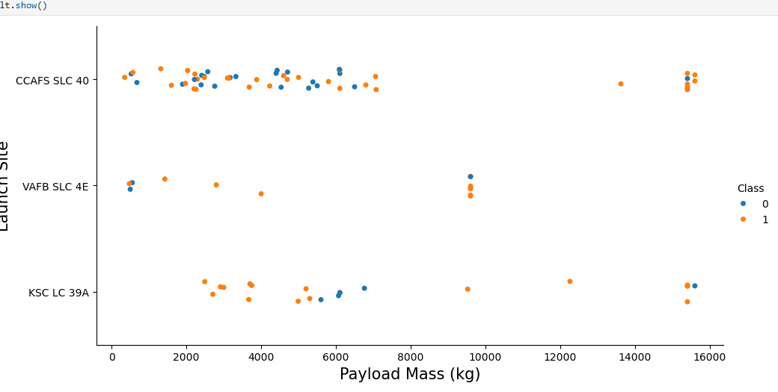
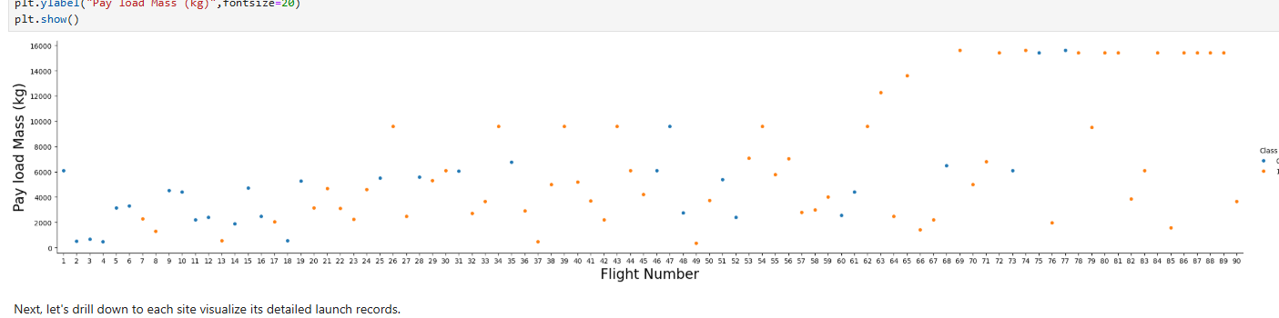
EDA Visualization Results: Launch Success Drivers
Slide 11
RESULTS
Flight number shows a visible relationship with success: later launches contain more successful landings, suggesting operational learning.
Payload mass alone does not fully determine success; successful landings occur across both lower and higher payload ranges.
Launch site patterns differ, showing that site-specific operations and mission profiles may affect landing outcomes.
IBM Data Science Capstone | SpaceX Falcon 9 Landing Prediction
Omkar Sawant

Slide 12
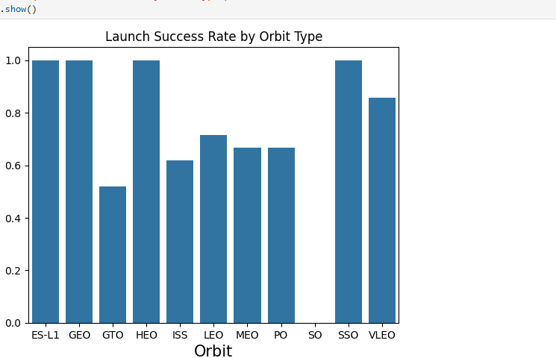
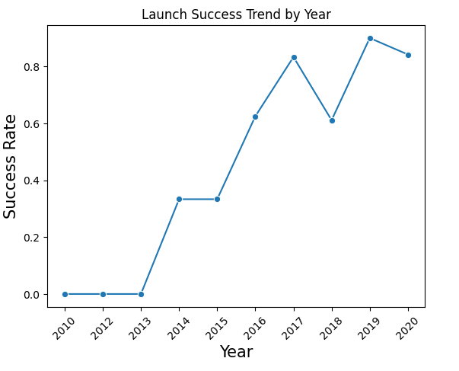
EDA Visualization Results: Orbit and Time Trends
Slide 12
Orbit result
Time trend result
Some orbit categories show very high success rates, while GTO and ISS missions show more mixed outcomes.
Success rate rises sharply after 2015 and remains comparatively strong in later years, supporting the learning-curve interpretation.
IBM Data Science Capstone | SpaceX Falcon 9 Landing Prediction
Omkar Sawant

Slide 13
EDA with SQL Results
Slide 13
SQL RESULTS
SQL question
Result / insight
Distinct launch sites
Four major sites were identified: CCAFS LC-40, CCAFS SLC-40, KSC LC-39A and VAFB SLC-4E.
Payload analysis
SQL aggregation helped summarize payload mass by customer, booster and mission type.
Landing outcomes
Mission and landing outcomes were grouped to compare success, failure, no-attempt and drone ship/ground pad outcomes.
First ground-pad success
The first successful ground pad landing occurred in December 2015.
Maximum payload missions
Several missions reached the maximum observed payload level of about 9,600 kg.
IBM Data Science Capstone | SpaceX Falcon 9 Landing Prediction
Omkar Sawant

Slide 14
Interactive Map Results Using Folium
Slide 14
Launch sites are positioned near coastlines, which supports safety and stage recovery logistics.
Marker clusters distinguish successful and failed landings using green/red markers.
Distance analysis measured proximity from launch site to coastline, city, railway and highway points.
Example CCAFS LC-40 proximities: coastline ~0.58 km, railway ~1.32 km, highway ~0.64 km, city ~18.07 km.
Deliverable
Interactive HTML maps saved in outputs/.
IBM Data Science Capstone | SpaceX Falcon 9 Landing Prediction
Omkar Sawant

Slide 15
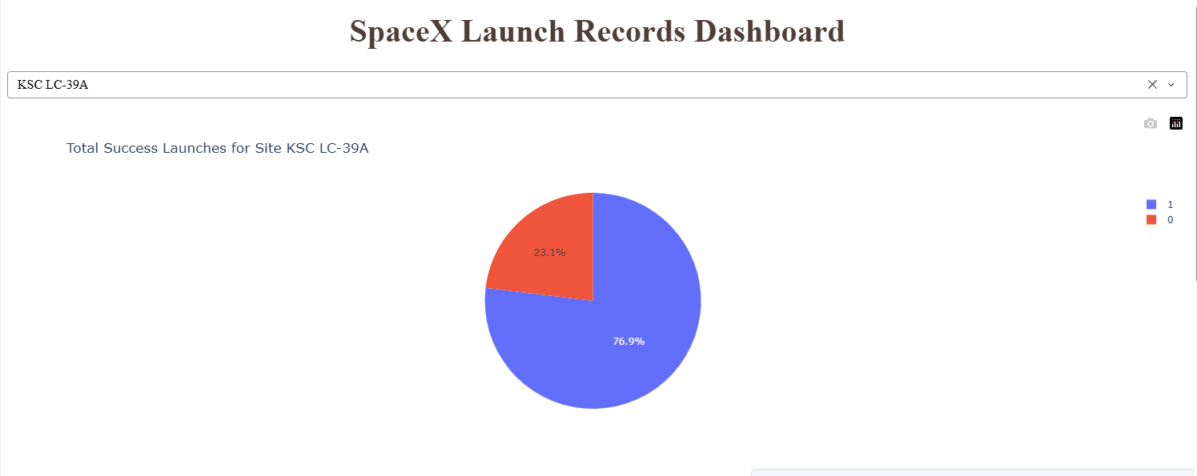
Plotly Dash Dashboard Results
Slide 15
DASHBOARD RESULTS
Launch site filter
Payload slider
Selecting KSC LC-39A showed a strong success share of 76.9% in the pie chart.
The scatter plot allows interactive filtering of payload mass and comparison by booster version category.
IBM Data Science Capstone | SpaceX Falcon 9 Landing Prediction
Omkar Sawant

Slide 16
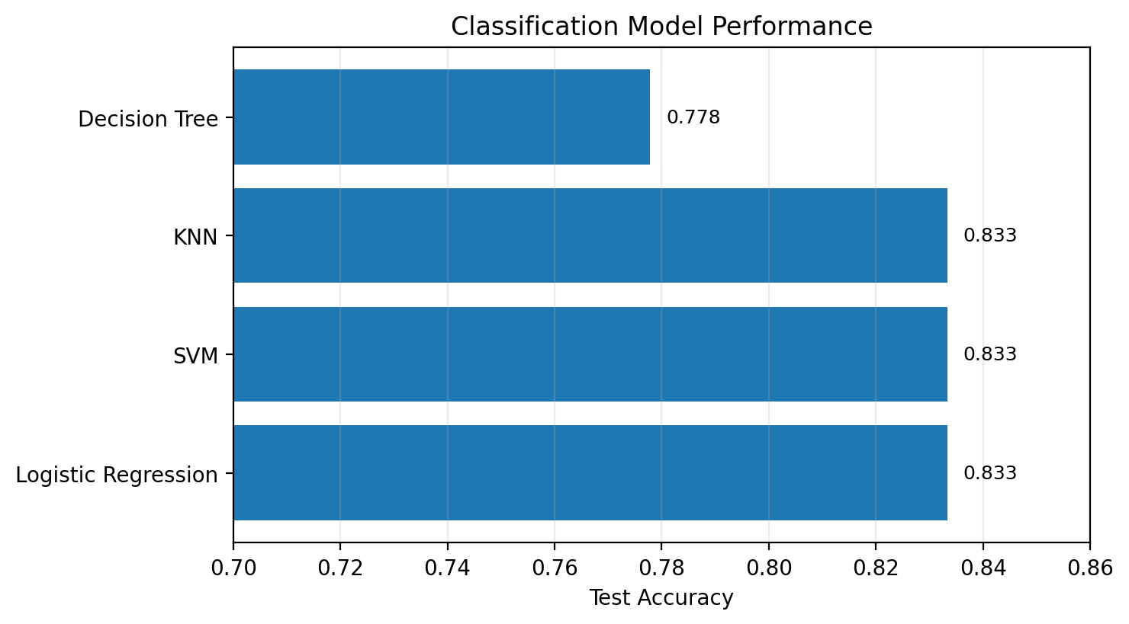
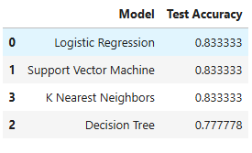
Predictive Analysis Results: Classification Models
Slide 16
ML RESULTS
Logistic Regression, Support Vector Machine and KNN tied for the highest test accuracy at 83.3%.
Decision Tree produced a lower test accuracy of 77.8%, suggesting slightly weaker generalization on the test split.
Because three models tied, a simpler model such as Logistic Regression is a practical final choice for interpretability and deployment.
IBM Data Science Capstone | SpaceX Falcon 9 Landing Prediction
Omkar Sawant

Slide 17
Innovative Insights and Business Implications
Slide 17
CREATIVITY + INSIGHTS
Learning curve
Mission context matters
Success rates improved in later years, suggesting operational refinement and booster recovery learning.
Launch site, orbit type and payload mass interact; no single variable fully explains success.
Booster category signal
Geospatial advantage
Dash scatter plot shows booster categories are useful for visual comparison of landing outcomes.
Coastal siting supports safe launch paths and recovery logistics while staying connected to nearby infrastructure.
Decision support
Model choice
Combining dashboard, maps and ML creates a richer tool for estimating mission risk and launch cost.
A tied top accuracy favors the simpler, more interpretable Logistic Regression model as a baseline.
IBM Data Science Capstone | SpaceX Falcon 9 Landing Prediction
Omkar Sawant

Slide 18
Conclusion
Slide 18
The full SpaceX Falcon 9 workflow was completed from data collection through final predictive modeling.
EDA, SQL and visual analytics showed clear relationships between launch success and time, orbit, launch site, payload mass and booster category.
Folium and Dash added interactive exploration beyond static charts.
Classification models predicted first-stage landing success with a best test accuracy of 83.3%.
The project demonstrates how data science can support launch cost estimation and mission planning.
Final recommendation
Use Logistic Regression as an interpretable baseline, while continuing to test larger datasets and more recent launch records.
Future work
Add weather, launch window, mission complexity and newer booster reuse history to improve predictive power.
IBM Data Science Capstone | SpaceX Falcon 9 Landing Prediction
Omkar Sawant

Slide 19
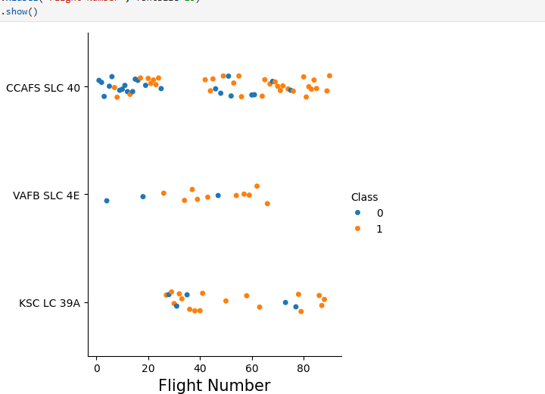
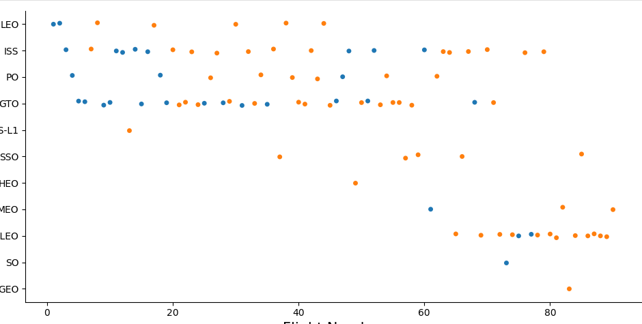
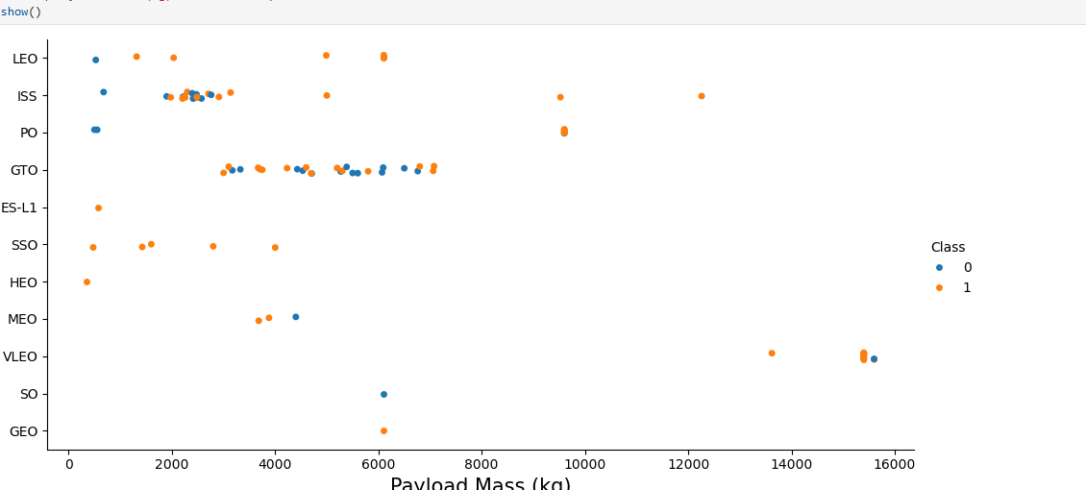
Appendix: Additional EDA Visuals
Slide 19
Additional visuals were used during analysis to compare flight number, payload mass, launch site and orbit type against landing success.
These visuals support the final interpretation that launch success is multi-factorial and has improved with experience.
IBM Data Science Capstone | SpaceX Falcon 9 Landing Prediction
Omkar Sawant

Slide 20
Appendix: Project Deliverables Checklist
Slide 20
✓
GitHub repository link
✓
Completed notebooks and Python files
✓
PDF presentation
✓
EDA, SQL, Folium, Dash and ML results
✓
Creative/innovative insights
https://github.com/OmkarSawant23/Data-Science-Capstone
IBM Data Science Capstone | SpaceX Falcon 9 Landing Prediction
Omkar Sawant

